Slide 1
Digital Image Processing
Chapter 2: Digital Image Fundamentals

Slide 2
Elements of Visual Perception
The eye is nearly a sphere (with a diameter of about 20 mm)
Enclosed by three membranes: the cornea and sclera outer cover, the choroid, and the retina
The Iris contracts or expands to control the amount of light that enters the eye
The central opening of the iris (the pupil) varies in diameter from approximately 2 to 8 mm
Glaucoma develops when the optic nerve becomes damaged. As this nerve gradually deteriorates, blind spots develop in your vision.
Elevated eye pressure happens as the result of a buildup of fluid that flows throughout the inside of the eye. This fluid also is known as the aqueous humor. It usually drains through a tissue located at the angle where the iris and cornea meet.
The lens absorbs approximately 8% of the visible light spectrum, with higher absorption at shorter wavelengths
Excessive clouding of the lens, referred to as cataracts, can lead to poor color discrimination and loss of clear vision

Slide 3
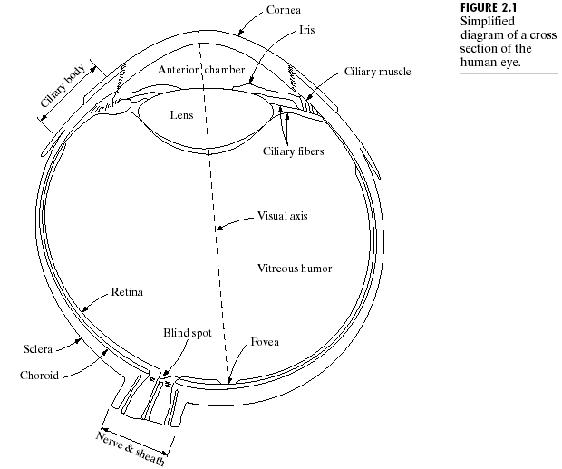
Elements of Visual Perception
Structure of the human eye

Slide 4
Elements of Visual Perception
The retina is at the innermost membrane of the eys
Pattern vision is afforded by discrete light receptors distributed over the surface of the retina
Two types of receptors: cones and rods
Cones
There are between 6 and 7 million cones in each eye
Located primarily in the central portion of the retina, called the fovea, and are highly sensitive to color
Cone vision is called photopic or bright-light vision
Rods
Some 75 to 150 million are distributed over the retina
Larger area of distribution
Not involved in color vision, and are sensitive to low levels of illumination
Scotopic or dim-light vision

Slide 5
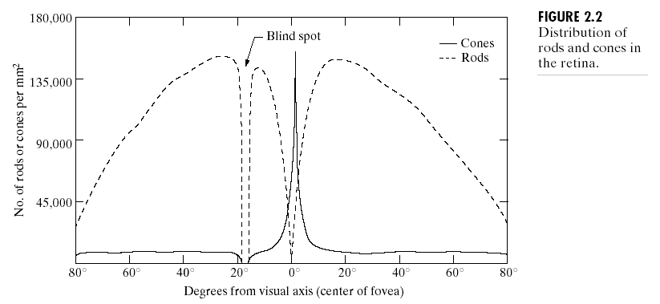
Rods and cones in the retina

Slide 6
Elements of Visual Perception
Image formation
Like pinhole cameras
In a pinhole camera, light passes through the pinhole to project an upside-down image onto the back of the box, and in the human eye, light passes through the lens to project an upside-down image on the back of the retina.
The distance between the center of the lens and the retina along the visual axis is approximately 17 mm
The focal length needed to achieve proper focus is obtained by varying the shape of the lens.
Depth perception
The physiological depth cues are accommodation, convergence, binocular parallax, and monocular movement parallax. Convergence and binocular parallax are the only binocular depth cues, all others are monocular.
The psychological depth cues are retinal image size, linear perspective, texture gradient, overlapping, aerial perspective, and shades and shadows.

Slide 7
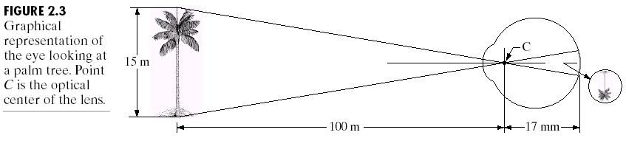
Image formation in the eye

Slide 8
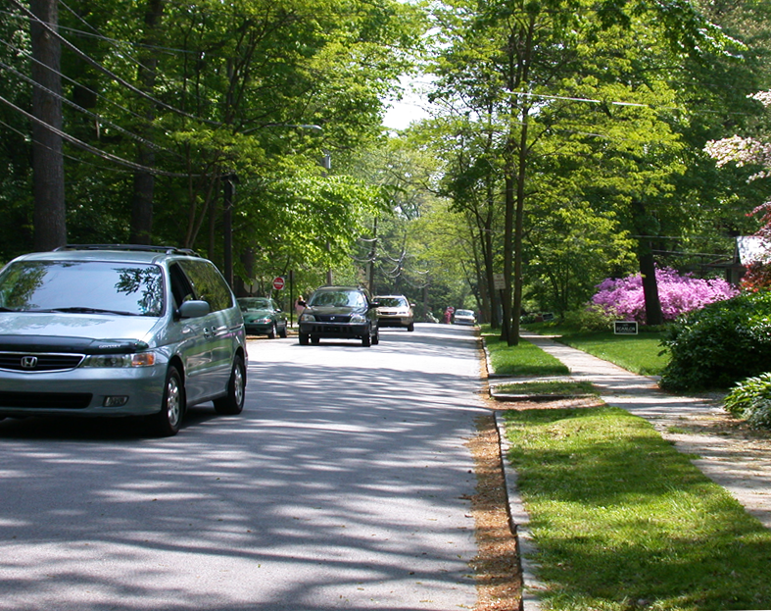
Elements of Visual Perception
Perspective, relative size, occultation and texture gradients all contribute to the three-dimensional appearance of this photo.
Extracts from https://en.wikipedia.org/wiki/Depth_perception

Slide 9
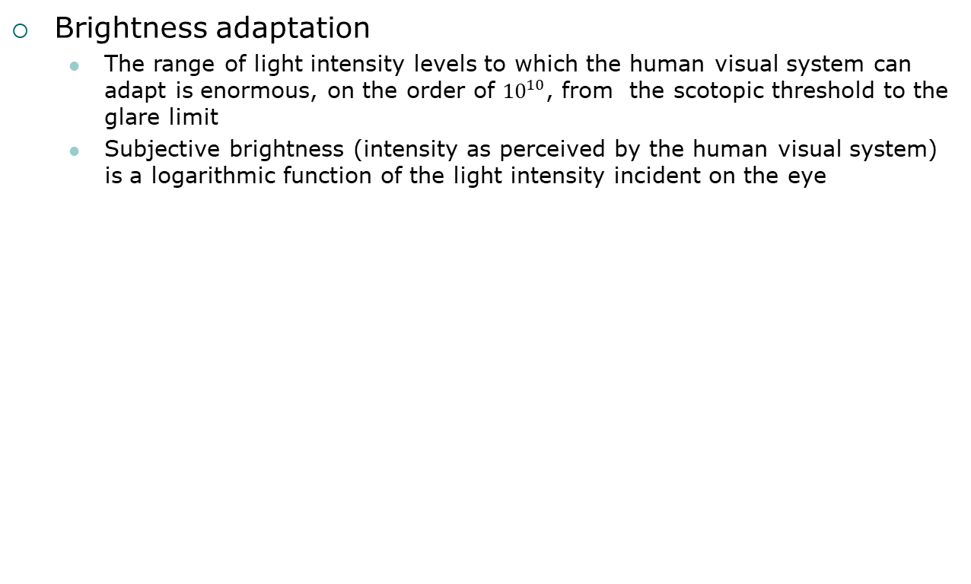
Elements of Visual Perception
Brightness adaptation
The range of light intensity levels to which the human visual system can adapt is enormous, on the order of ${10}^{10}$, from the scotopic threshold to the glare limit
Subjective brightness (intensity as perceived by the human visual system) is a logarithmic function of the light intensity incident on the eye

Slide 10
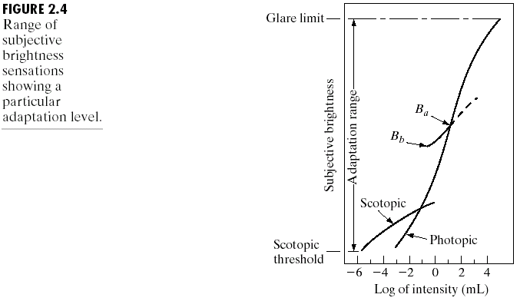
Brightness adaptation and discrimination

Slide 11
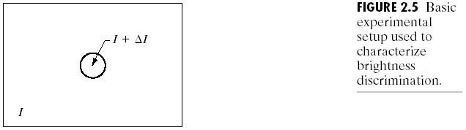
Brightness discrimination

Slide 12
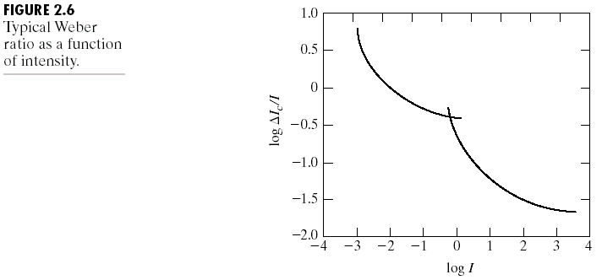
Weber ratio

Slide 13
Perceived brightness

Slide 14
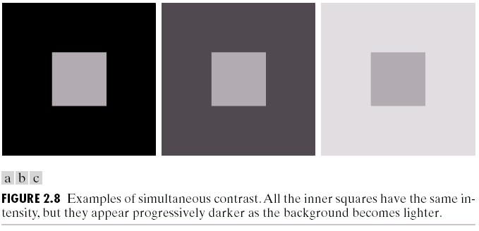
Simultaneous contrast

Slide 15
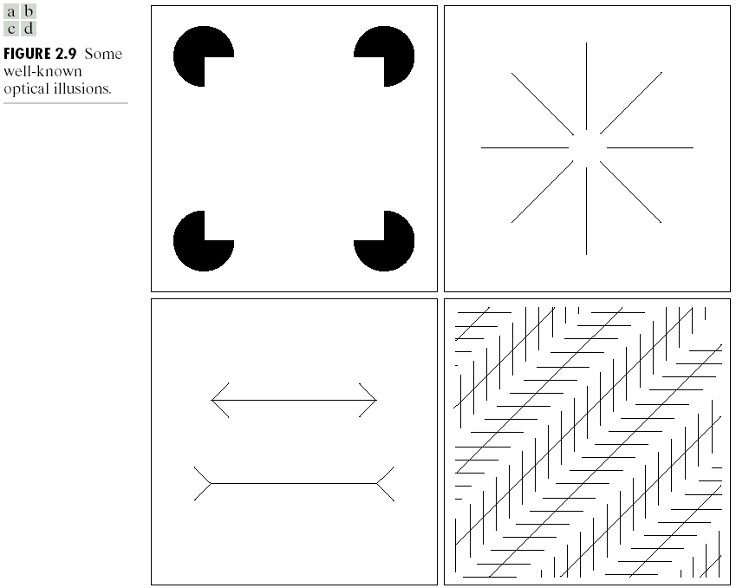
Optical illusion

Slide 16
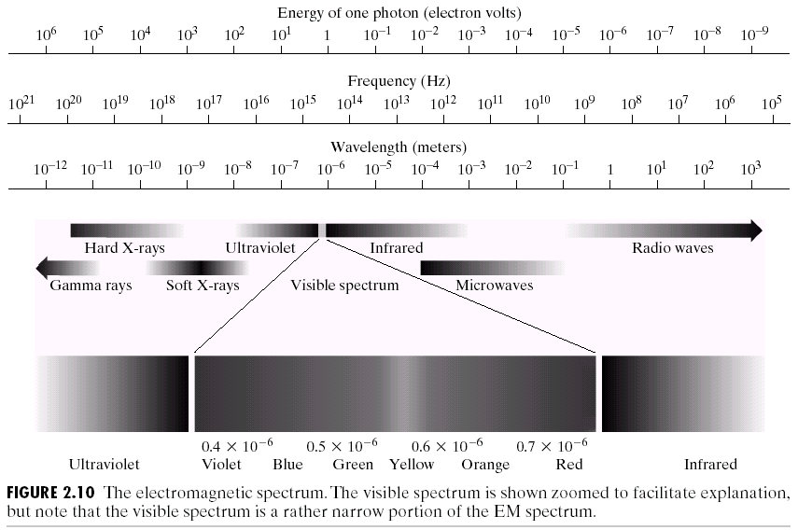
Light and the Electromagnetic Spectrum

Slide 17
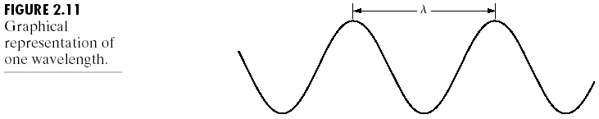
Wavelength

Slide 18
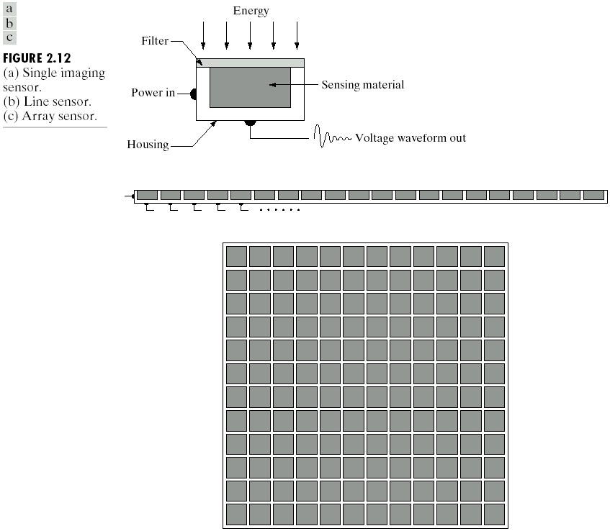
Image Sensing and Acquisition

Slide 19
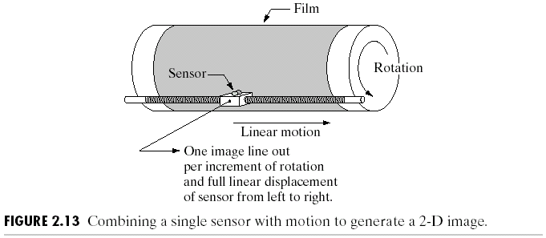
Image acquisition using a single sensor

Slide 20
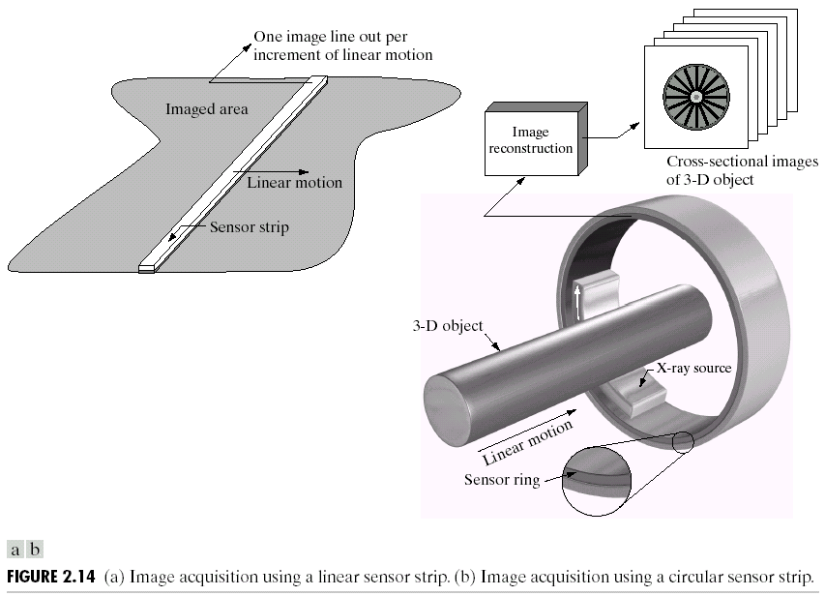
Using sensor strips

Slide 21

A simple image formation model

Slide 22
Illumination and reflectance
Illumination and transmissivity

Slide 23
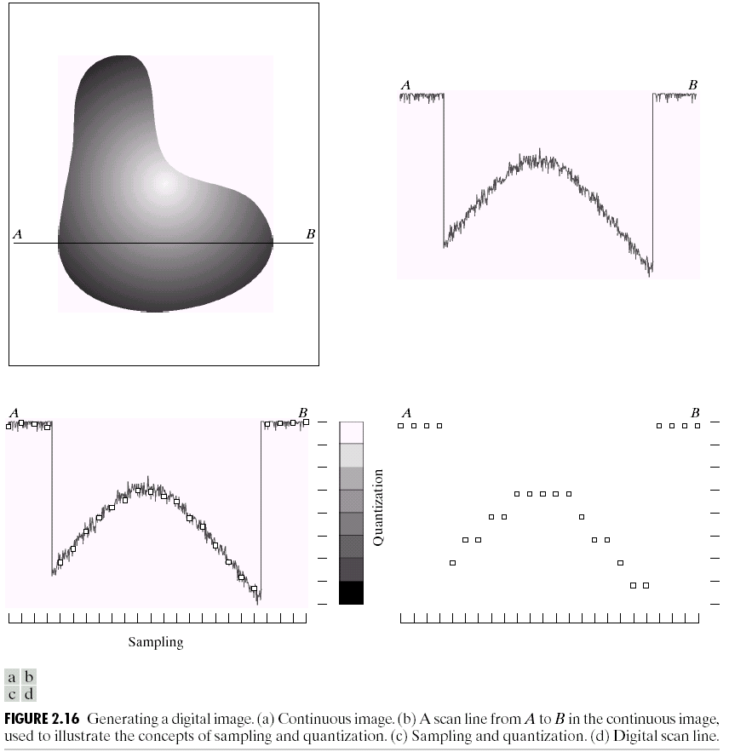
Image Sampling and Quantization

Slide 24

Sampling and quantization

Slide 25
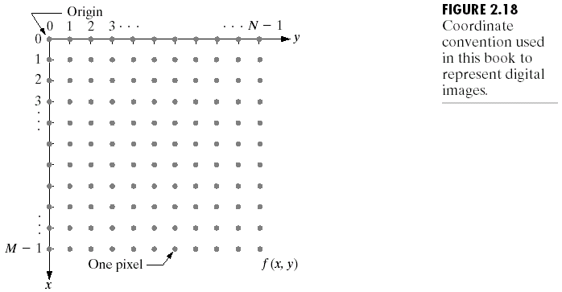
Representing digital images

Slide 27
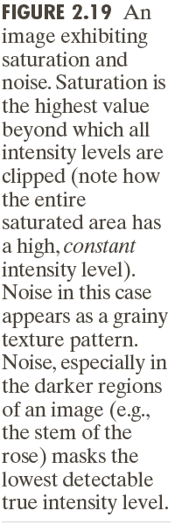
Saturation and noise

Slide 28
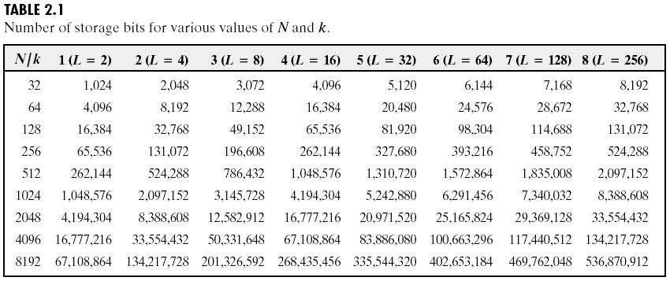
Number of storage bits

Slide 29
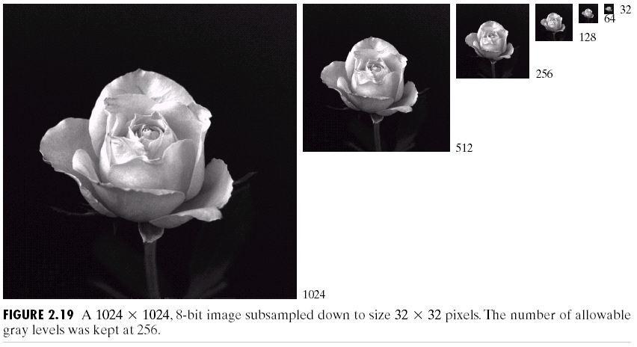
Spatial and gray-level resolution

Slide 30
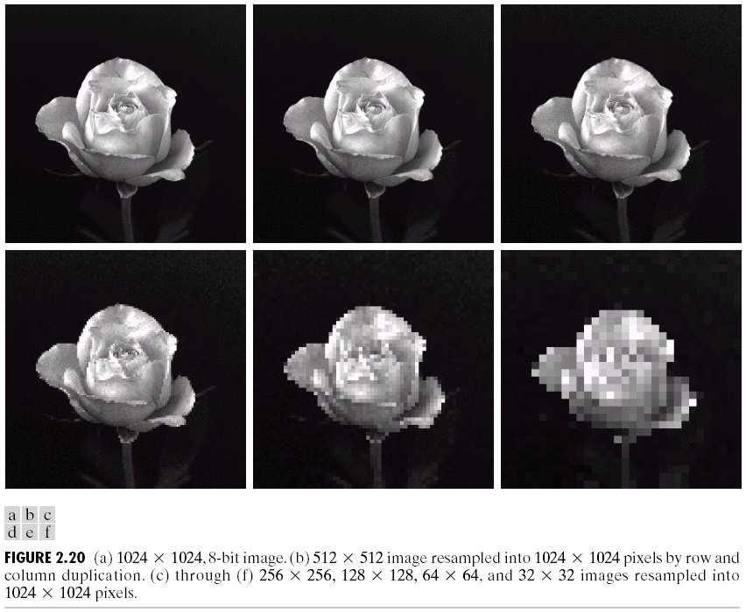
Subsampled and resampled

Slide 31
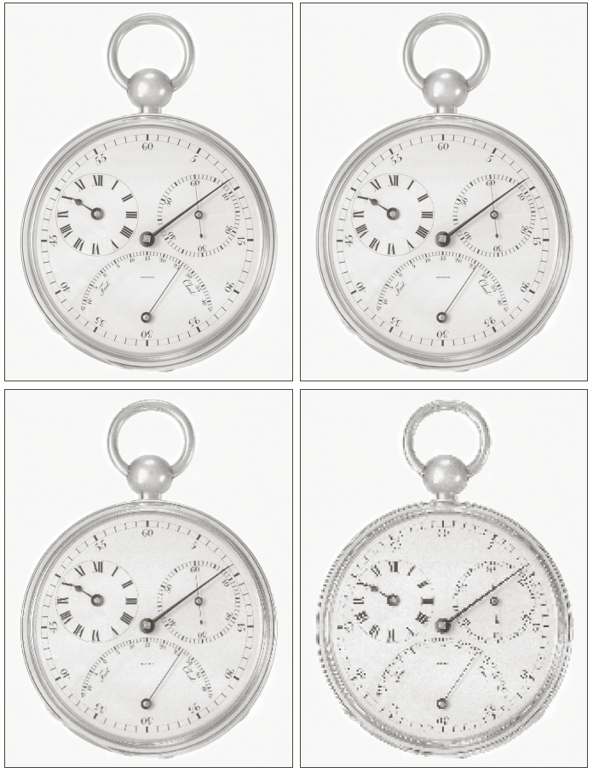
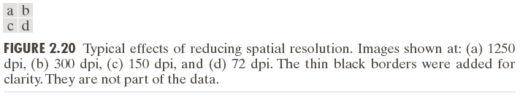
Reducing spatial resolution

Slide 32
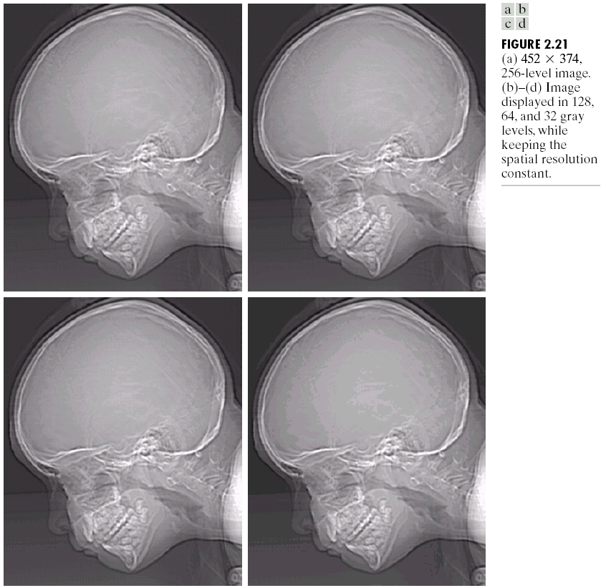
Varying the number of gray levels

Slide 33
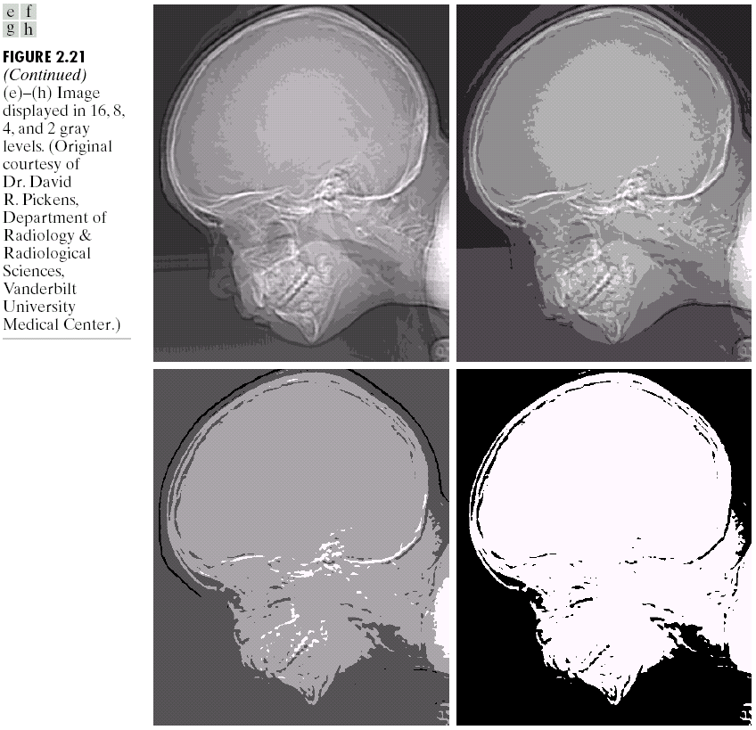
Varying the number of gray levels

Slide 34
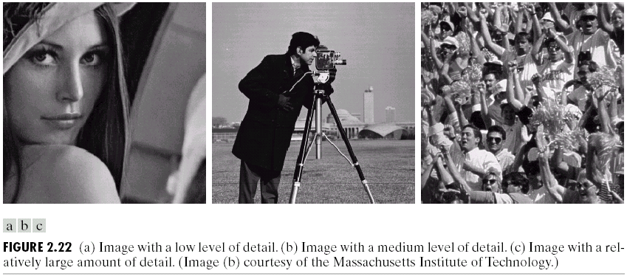
N and k in different-details images

Slide 35
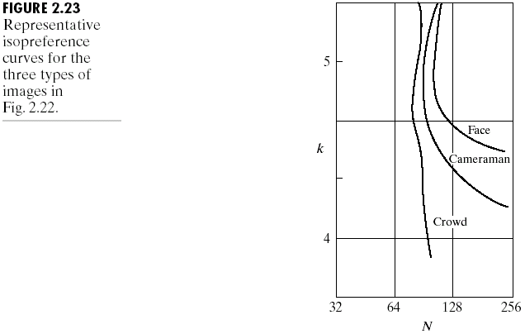
Isopreference

Slide 36
Interpolations

Slide 37
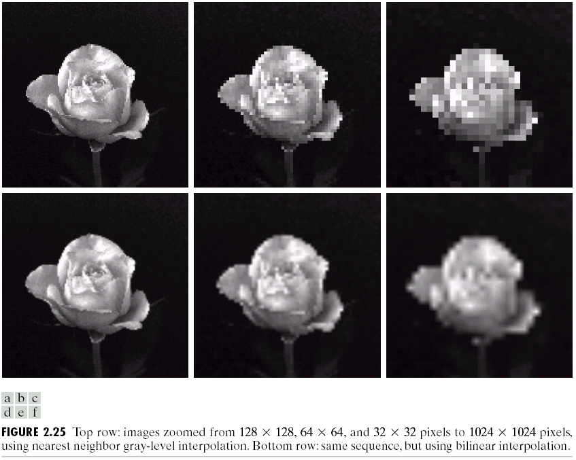
Zooming and shrinking

Slide 38
Some Basic Relationships Between Pixels
Neighbors of a pixel
: 4-neighbors of p
, , ,
: four diagonal neighbors of p
, , ,
: 8-neighbors of p
and

Slide 39
Adjacency
: The set of gray-level values used to define adjacency
4-adjacency: Two pixels p and q with values from V are 4-adjacency if q is in the set
8-adjacency: Two pixels p and q with values from V are 8-adjacency if q is in the set

Slide 40
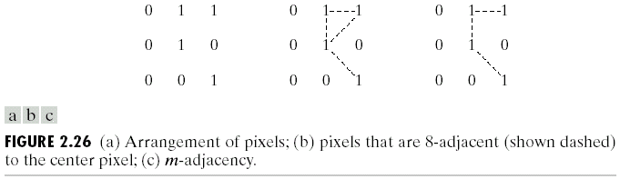
m-adjacency (mixed adjacency): Two pixels p and q with values from V are m-adjacency if
q is in , or
q is in and the set has no pixels whose values are from V

Slide 42
Subset adjacency
S1 and S2 are adjacent if some pixel in S1 is adjacent to some pixel in S2
Path
A path from p with coordinates to pixel q with coordinates is a sequence of distinct pixels with coordinates
, ,…,
where = , = , and pixels and are adjacent

Slide 43
Region
We call R a region of the image if R is a connected set
Boundary
The boundary of a region R is the set of pixels in the region that have one or more neighbors that are not in R
Edge
Pixels with derivative values that exceed a preset threshold

Slide 44
Distance measures
Euclidean distance
City-block distance
Chessboard distance

Slide 45
distance: The shortest m-path between the points

Slide 46
An Introduction to the Mathematical Tools Used in Digital Image Processing
Linear operation
H is said to be a linear operator if, for any two images f and g and any two scalars a and b,

Slide 47
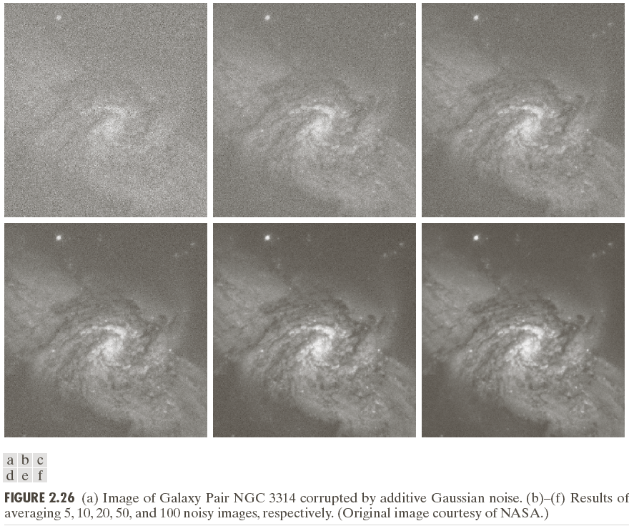
Arithmetic operations
Addition

Slide 48
Arithmetic operations
Subtraction

Slide 49
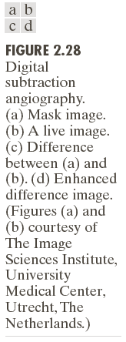
Digital subtraction angiography

Slide 50
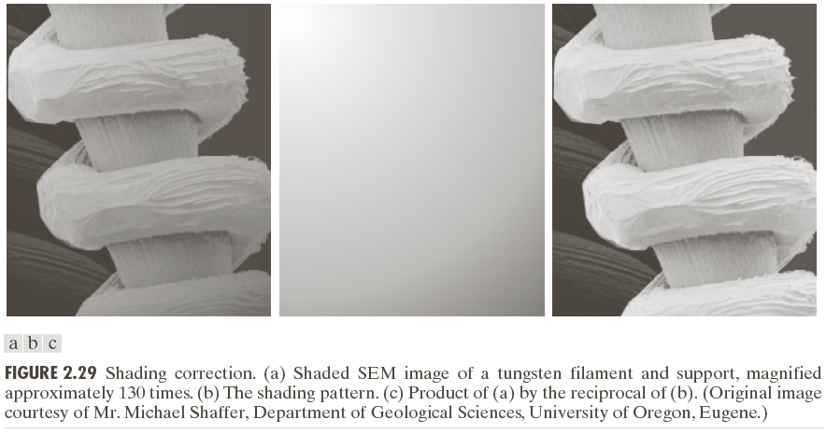
Shading correction

Slide 51
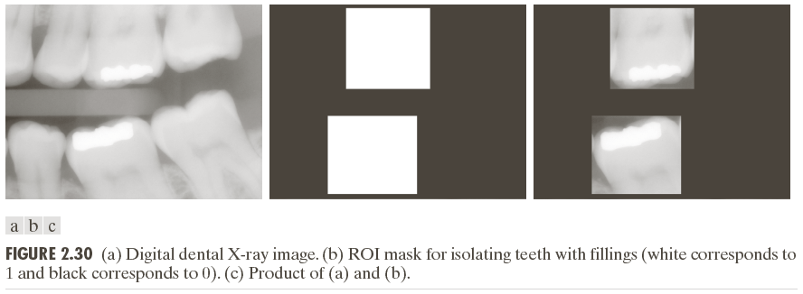
Image multiplication

Slide 52
Set operations

Slide 53
Complements

Slide 54
Logical operations

Slide 55
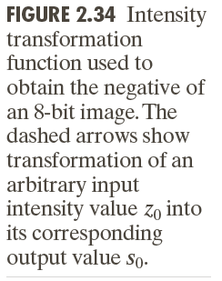
Single-pixel operations

Slide 56
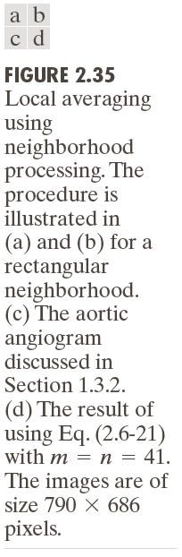
Neighborhood operations

Slide 57
Affine transformations

Slide 58
Inverse mapping

Slide 59
Registration

Slide 60
Vector operations

Slide 61
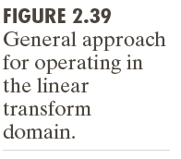
Image transforms

Slide 62
Fourier transform

Slide 63
Probabilistic methods

Slide 64
Problems
2.2
Using the background information provided in Section 2.1, and thinking purely in geometrical terms, estimate the diameter of the smallest printed dot that the eye can discern if the page on which the dot is printed is 0.2 m away from the eyes. Assume for simplicity that the visual system ceases to detect the dot when the image of the dot on the fovea becomes smaller than the diameter of one receptor (cone) in that area of the retina. Assume further that the fovea can be modeled as a square array of dimension 1.5 mm on the side, and that the cones and spaces between the cones are distributed uniformly throughout this array.

Slide 65
Problems
2.6
A CCD camera chip of dimensions 7 x 7 mm and 1024x1024 sensing elements, is focused on a square, flat area, located 0.5 m away. The camera is equipped with a 35-mm lens. How many line pairs per mm will this camera be able to resolve? (Hint: Model the imaging process as in Fig. 2.3, with the focal length of the camera lens substituting for the focal length of the eye.)

Slide 66
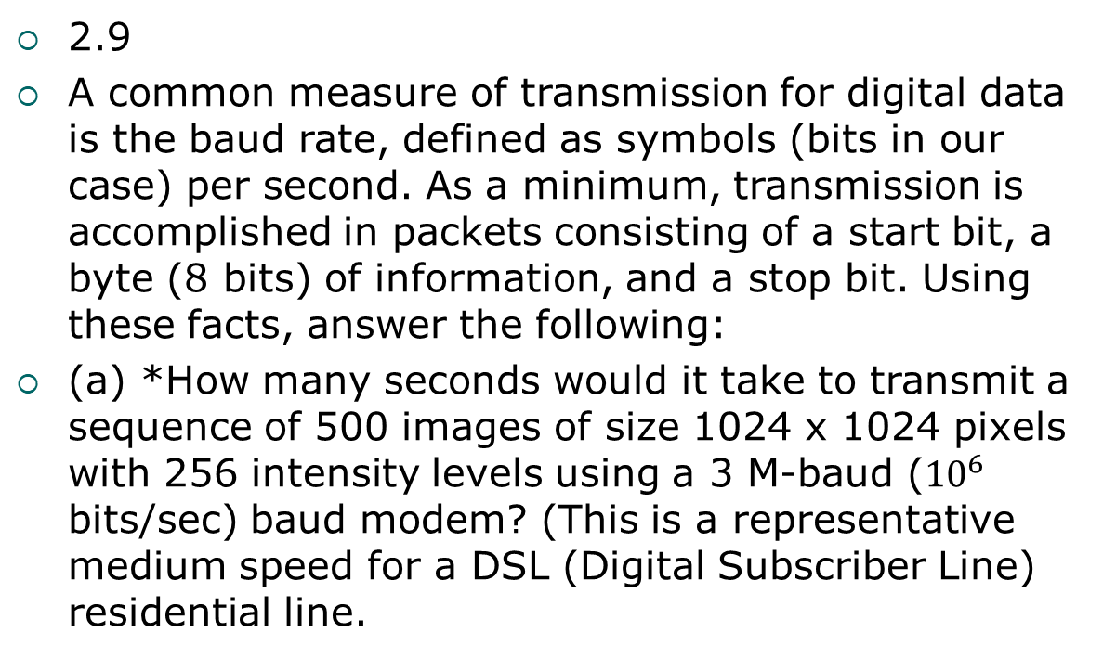
Problems
2.9
A common measure of transmission for digital data is the baud rate, defined as symbols (bits in our case) per second. As a minimum, transmission is accomplished in packets consisting of a start bit, a byte (8 bits) of information, and a stop bit. Using these facts, answer the following:
(a) *How many seconds would it take to transmit a sequence of 500 images of size 1024 x 1024 pixels with 256 intensity levels using a 3 M-baud (${10}^{6}$ bits/sec) baud modem? (This is a representative medium speed for a DSL (Digital Subscriber Line) residential line.

Slide 67
Problems
2.18
Consider the image segment shown in the figure that follows.
(a)*As in Section 2.5, let V={0,1} be the set of intensity values used to define adjacency. Compute the lengths of the shortest 4-, 8-, and m-path between p and q in the following image. If a particular path does not exist between these two points, explain why.

Slide 68
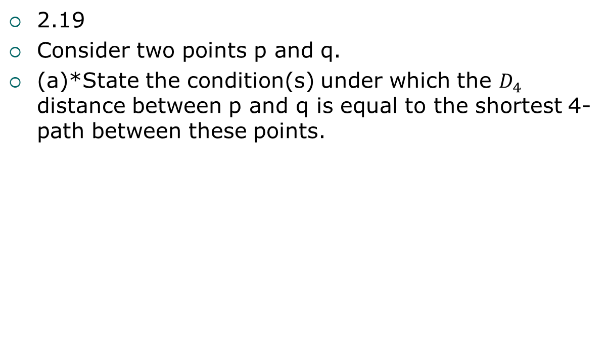
Problems
2.19
Consider two points p and q.
(a)*State the condition(s) under which the $D_{4}$ distance between p and q is equal to the shortest 4-path between these points.

Slide 69
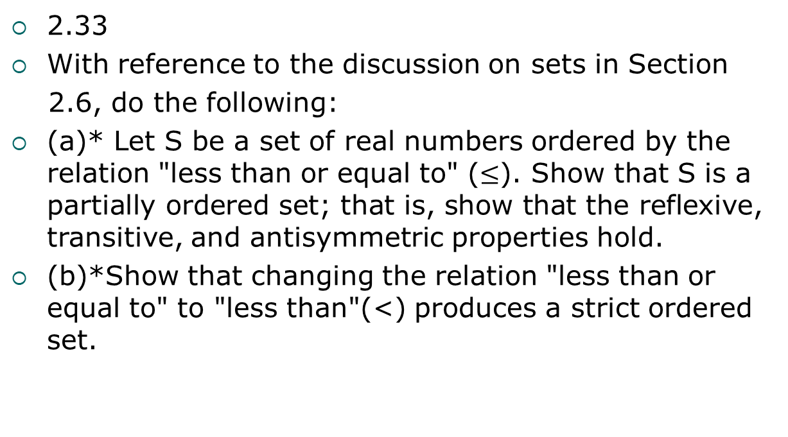
Problems
2.33
With reference to the discussion on sets in Section
2.6, do the following:
(a)* Let S be a set of real numbers ordered by the relation "less than or equal to" ($≤$). Show that S is a partially ordered set; that is, show that the reflexive, transitive, and antisymmetric properties hold.
(b)*Show that changing the relation "less than or equal to" to "less than"(<) produces a strict ordered set.

Slide 70
Problems
2.36
With reference to Table 2.3, provide single, composite transformation functions for performing the following operations:
(a)* Scaling and translation.
(b)* Scaling, translation, and rotation.

Slide 71
Problems
2.40
Show that 2-D transforms with separable, symmetric kernels can be computed by: (1) computing 1-D transforms along the individual rows (columns) of the input image; and (2) computing 1-D transforms along the columns (rows) of the result from step (1).

